Slide 1

Building the €100 data warehouse with the Azure Data Platform
(okay and maybe a little bit of Fabric)
Koen Verbeeck - He / him

Slide 2


Slide 3







Contact
Koen Verbeeck
former
@Ko_Ver
@koenv.bsky.social
SQLkover.com

Slide 4

Building a €100 data warehouse
Notes:
Everyone thinks they need this

Slide 5

Building a €100 data warehouse
Notes:
But some companies only need this

Slide 6
Building a €100 data warehouse
there are some assumptions…
Notes:
sorry for the clickbait

Slide 7
Building a €100 data warehouse
single environment
ETL/ELT once a day
€100/month
Notes:
data is stored in SQL DB
cloud sources & public Internet
Power BI license cost not included

Slide 8
Building a €100 data warehouse
if we can get the cost down to €100…
Notes:
sorry for the clickbait

Slide 9

what’s the most expensive part?
Notes:
sorry for the clickbait

Slide 10
Building a €100 data warehouse
aside from setting up a cost-effective architecture,
we’ll also optimize development efficiency
Notes:
sorry for the clickbait

Slide 11
agenda
architecture
ingest
transform
model & serve
but what about Fabric?

Slide 12
architecture

Slide 13
typical architecture
Analytics
Data platform
Ingestion
Transformation
Serving
Data Sources
Machine Learning
Storage
Integration
Undercurrents
Security
Data Management
DataOps
Data Architecture
Orchestration
Software Engineering
Cost Management
Inspired by: Fundamentals of Data Engineering [O’Reilly, 2022]

Slide 14
we’re building a (simple) DWH
Analytics
Data platform
Ingestion
Transformation
Serving
Data Sources
Machine Learning
Storage
Integration
Undercurrents
Security
Data Management
DataOps
Data Architecture
Orchestration
Software Engineering
Cost Management

Slide 15





we’re building a (simple) DWH
Analytics
Data platform
Ingestion
Transformation
Serving
Data Sources
Storage
Undercurrents
Security
Data Management
DataOps
Data Architecture
Orchestration
Software Engineering
Cost Management
Entra ID
DevOps
Data Factory
DevOps
Cost Management
Key Vault
Terraform
Repos
Power BI

Slide 16


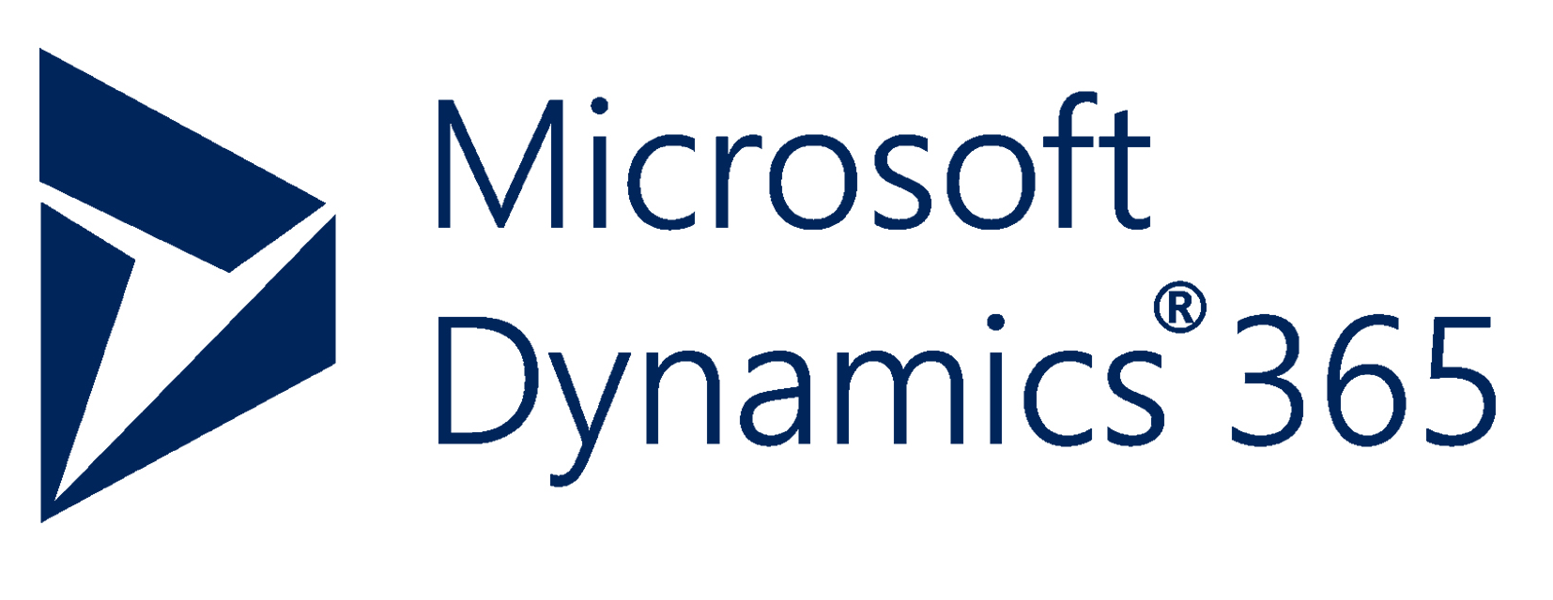


we’re building a (simple) DWH
Analytics
Data platform
Ingestion
Transformation
Serving
Data Sources
Storage
Undercurrents
Security
Data Management
DataOps
Data Architecture
Orchestration
Software Engineering
Cost Management
Entra ID
DevOps
Data Factory
DevOps
Cost Management
Key Vault
Terraform
Repos
Power BI

Slide 17
ingest

Slide 18
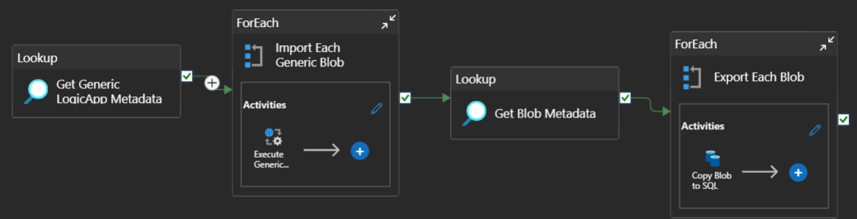
Azure Data Factory

Slide 19
metadata driven
develop something once
(for example, a connection to your ERP system)
parameterize it
new table/file/REST endpoint? Just add metadata
try to get metadata of the source programmatically

Slide 20
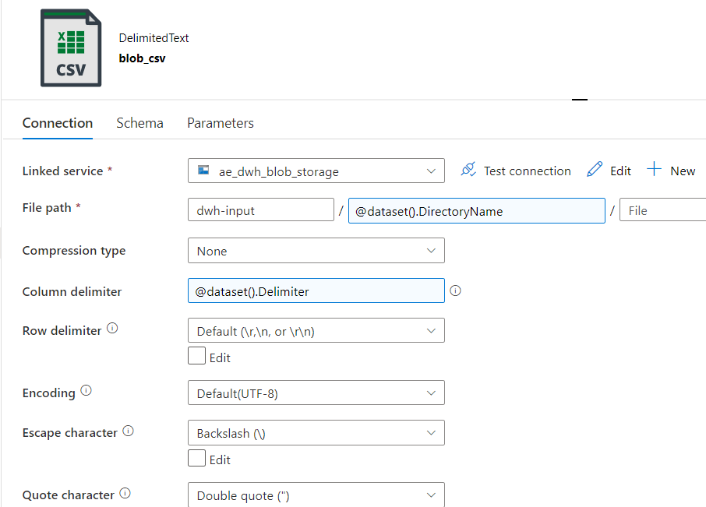
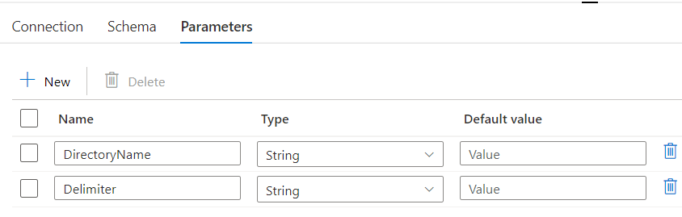
parameterize everything

Slide 21
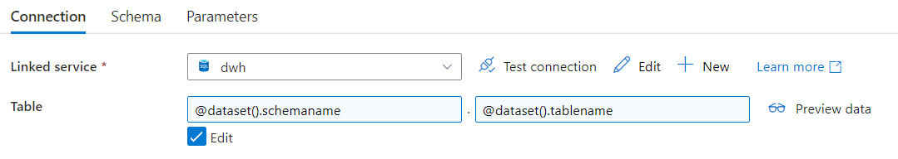
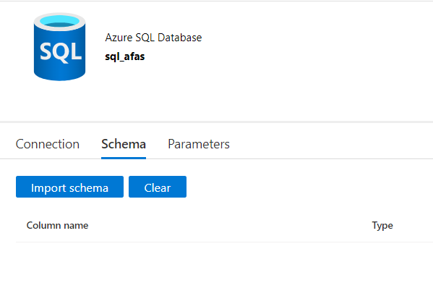
parameterize everything

Slide 22
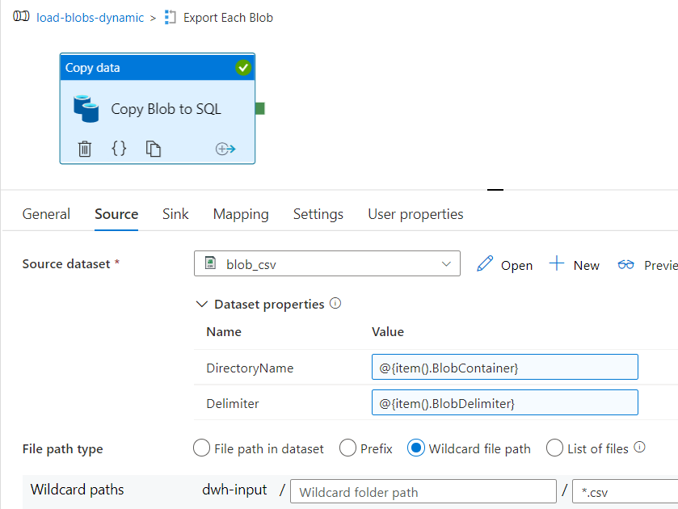
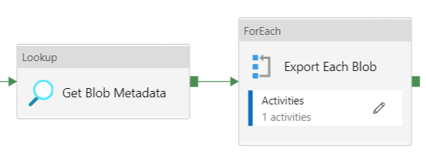
fetch metadata & loop

Slide 23
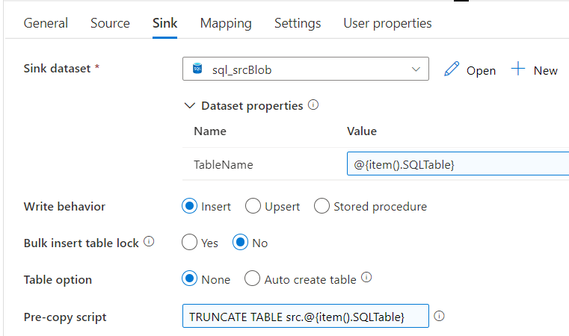
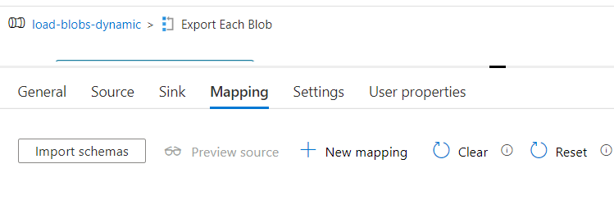
fill in parameters at runtime
no need for mapping in simple use cases
→ use same column names!
use dynamic content

Slide 24
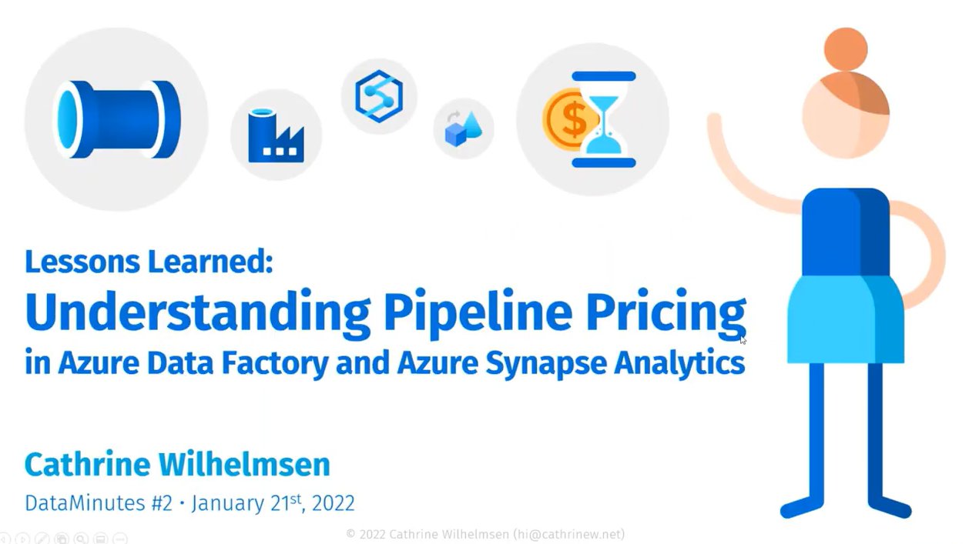
cost
https://youtube.com/watch?v=Fct1dcZMyWs

Slide 25
important to remember
ALL ACTIVITIES ARE PRO-RATED BY THE MINUTE
AND ROUNDED UP

Slide 26
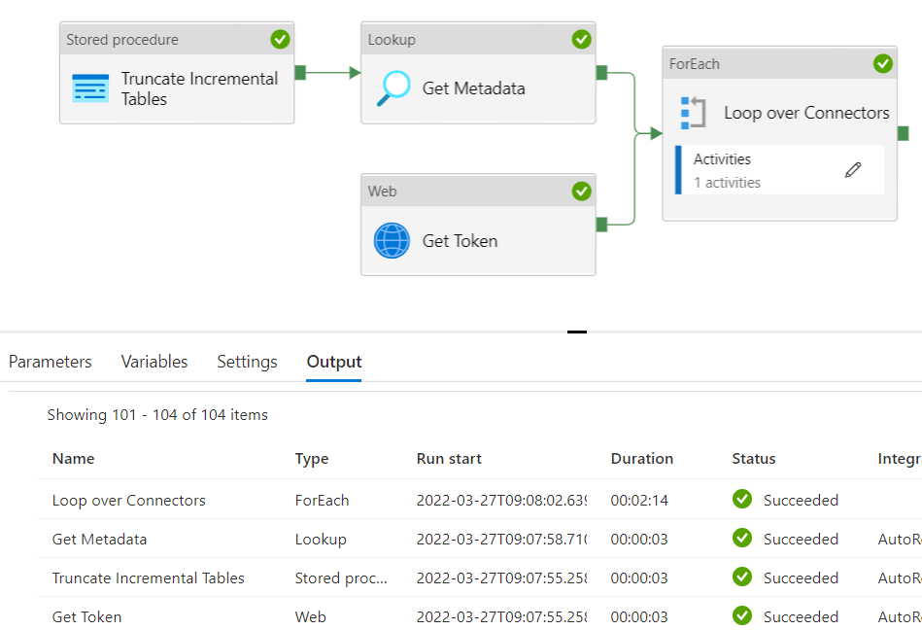
example
2 minutes and 23 seconds runtime

Slide 27
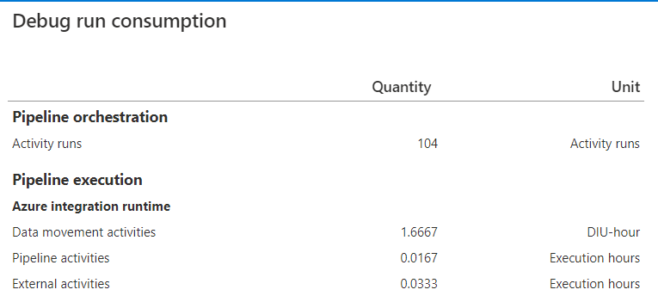
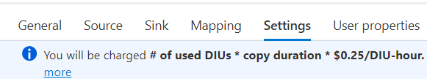
example
Orchestration (Azure-IR): $0.001/run
Pipeline (Azure-IR): $0.005/hour
$0,0000835/run
External (Azure-IR): $0.00025/hour
$0,000008325/run
Data Movement (Azure-IR): $0,25/hour
→ 2 * 1.6667 * $0.25 = $0,83335/run
$0,834441825 / run
once every day: $25.03
once every hour: $600.80
once every 5 min: $7209.58
1 minute
100 minutes!
2 minutes

Slide 28
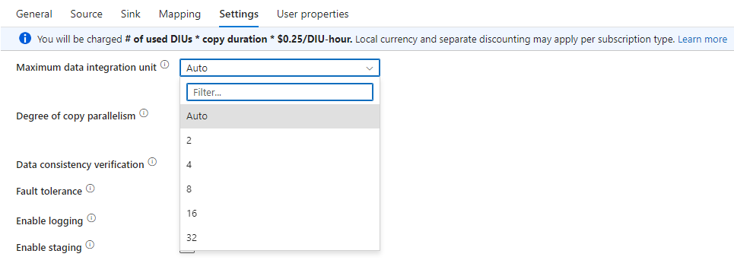
50% cost saving with one single config

Slide 29
move compute to somewhere else
preferably to something that doesn’t have pricing per minute
such as an Azure SQL DB
  scale up before ELT
  scale down once ELT is done
or to compute that is just cheaper
Azure Functions or Azure Logic Apps are good alternatives
for bigger workloads, maybe consider using a self-hosted IR in a VM

Slide 30
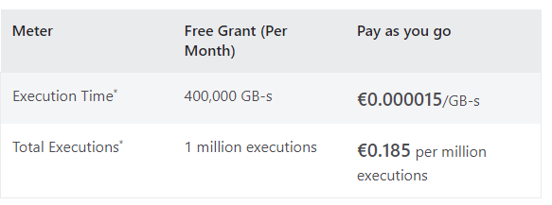
Azure Functions

Slide 31
resources
Azure Data Factory and the Exact Online REST API
Reading AFAS REST API Data with Azure Logic Apps
Build Once – Add Metadata (the importance of metadata-driven frameworks)
Dynamic Datasets in Azure Data Factory
Building Flexible and Dynamic Azure Data Factory Pipelines
Dynamically Map JSON to SQL in Azure Data Factory

Slide 32
demo

Slide 33
transform

Slide 34

it’s all SQL
metadata
staging
DWH
views

Slide 35

and it’s all about patterns

Slide 36
type 1 dimension
yes
insert
NEW?
yes
update
basic data quality checks + business logic
staging
<> hash?
no
no
ignore

Slide 37
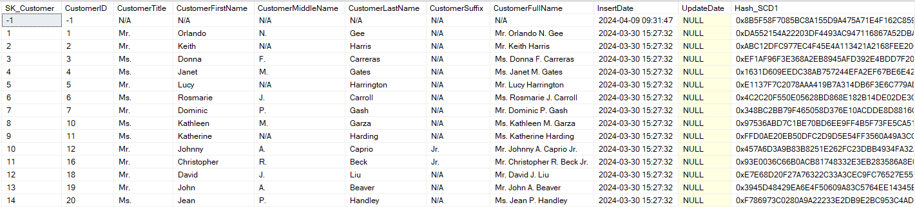
type 1 dimension
dummy record
hash
SK = identity(1,1) = PK
audit columns
BK = unique index

Slide 38
type 2 dimension
yes
insert
NEW?
yes
insert
same as in type 1
<> type 2 hash?
staging
no
yes
update
<> type 1 hash?
no
no
ignore

Slide 39
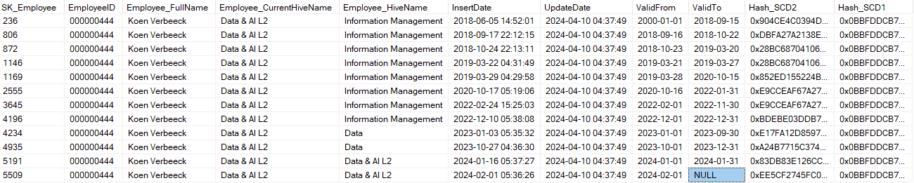
type 2 dimension
hashes
SK = identity(1,1) = PK
audit columns
BK + valid from = unique index

Slide 40
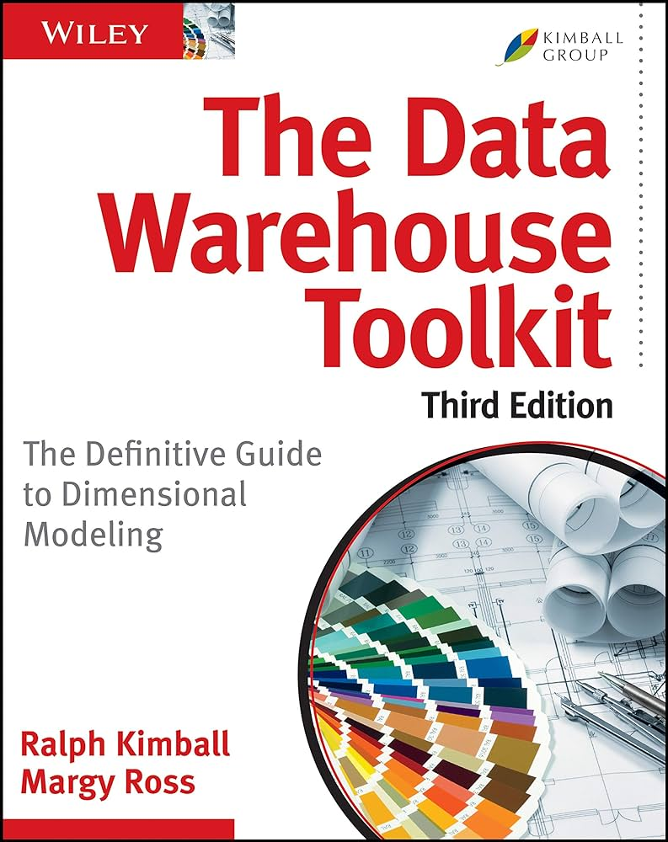
facts
transactional
  TRUNCATE TABLE + full load is default
  if necessary, incremental load on some column
snapshot
  view on source returns current snapshot
  INSERT current snapshot in fact table
  DELETE first if the current snapshot is already in the fact table
accumulating snapshot
  view returns current state
  INSERT for new items
  UPDATE for existing items

Slide 41

exceptions
don’t use views when
  performance is suffering
  the logic is becoming too complex,
  and you want to cut it into pieces
  you know… as a last resort
  use stored procs instead

Slide 42
metadata
dependencies between tables
  first dimensions
  then facts
  then facts on top of other facts
business keys & which loading pattern
ADF loops over this table and executes all statements in the correct order

Slide 43
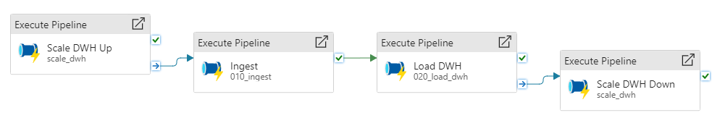
ELT flow
Notes:
Don’t forget to add alerting/monitoring + refresh Power BI

Slide 44
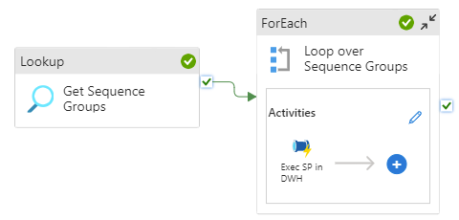
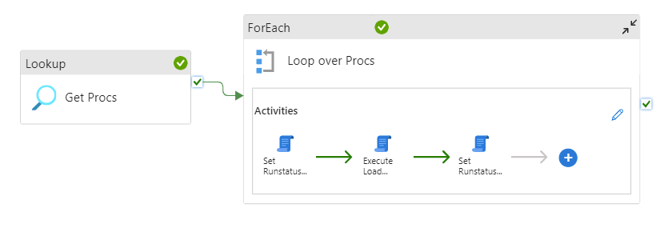
ELT flow – load DWH

Slide 45
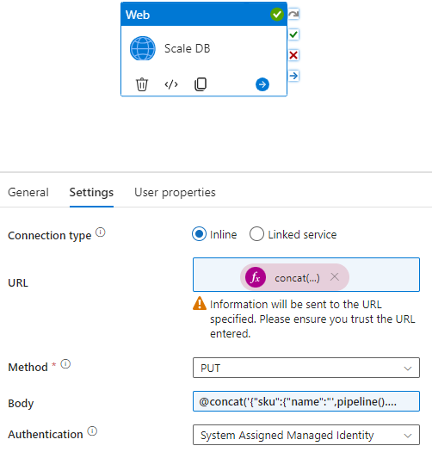
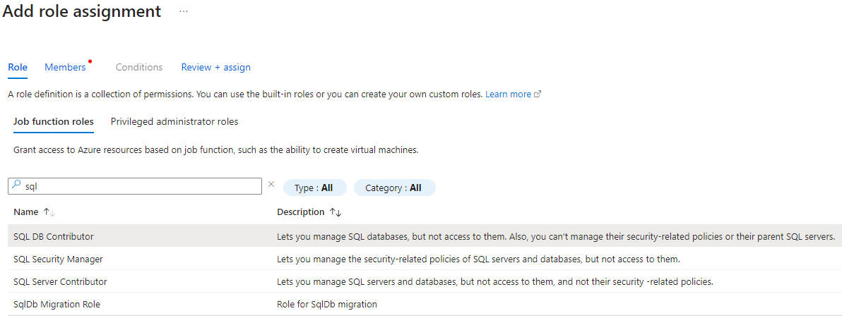
scale DWH up and down

Slide 46
resources
How To Scale Azure SQL Database In Azure Data Factory Using A Web Activity

Slide 47
demo

Slide 48
model & serve

Slide 49
Power BI

Slide 50

Power BI
1 central model in a workspace only admins have access to
reports are connected to this central semantic model and have their own workspace/apps
import mode FTW
resize database to S0 once Power BI has finished processing
ADF can orchestrate this using the Power BI REST API

Slide 51
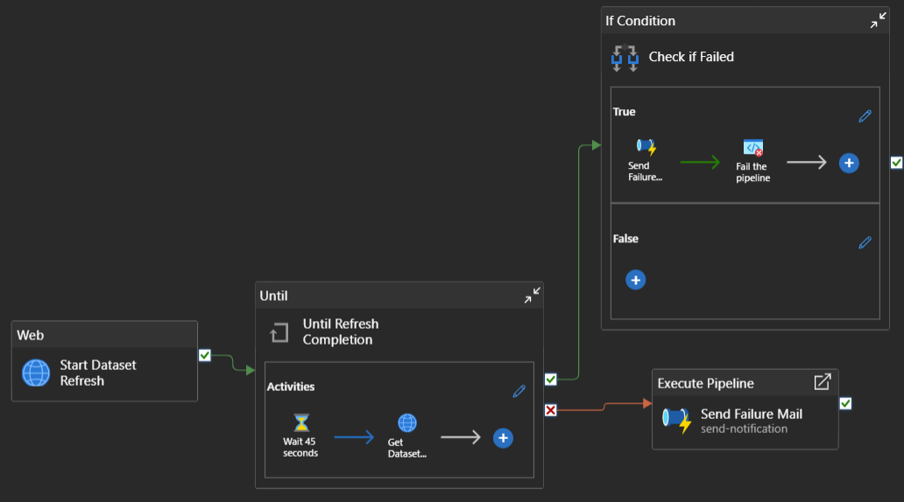

Slide 52
resources
Refreshing a Power BI Dataset using Azure Data Factory

Slide 53
CI / CD

Slide 54
Azure Devops
source control = git in Azure Repos
  database: Visual Studio (SSDT) & SSMS
  Azure Functions: Visual Studio (Code)
  ADF: browser
build pipelines runs after commit to main
release pipelines to test/prod run manually
private project is free in Azure Devops when <= 5 devs

Slide 55
what about Fabric?

Slide 56

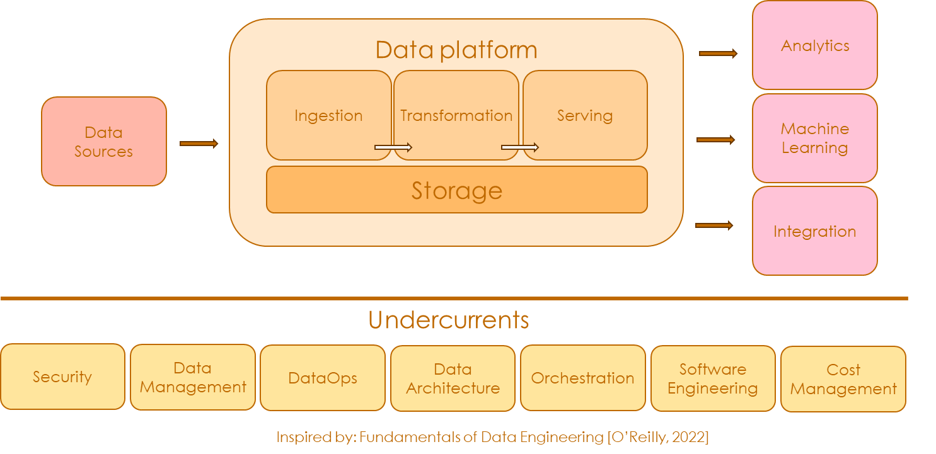





everything in one single platform
Power BI
Synapse
RT Analytics
Notebooks
Warehouse
Data
Factory
Lakehouse
Synapse
Data Science
OneLake
Data Factory
Data Activator
Entra ID
Purview
DevOps
Data Factory
DevOps
Cost Management
Key Vault
Terraform
Repos
Power BI

Slide 57
Fabric can be cheap…
either start with a low capacity and pause/resume
or go for the reserved capacity with discount
typically, the more code, the less CU usage
  lakehouse + notebooks for ingestion
  warehouse for dimensional model
Fabric Data Pipelines is essentially the same as in Azure
Fabric can be a bit more expensive than similar services in Azure due to its SaaS nature

Slide 58
great potential, but…
some enterprise features are still missing
  Key Vault (now in preview)
  CI / CD for all artefacts (almost done now)
T-SQL is not 100% the same
  IDENTITY has limitations
  no PK & FK
  limited VARCHAR(MAX)
  but we now have SQL DB! (unfortunately, it’s slow and expensive)
licensing with capacities can be confusing
  how much did we consume exactly?
you still need Power BI Pro
I’d still use Power BI import mode

Slide 59
resources
Fabric February: An End-to-End Showcase of a Metadata-Driven Microsoft Fabric Framework

Slide 60
conclusion

Slide 61
Building a €100 data warehouse
focus on having a metadata driven architecture
minimize costs in ADF
  change the defaults
  outsource the compute
  don’t run it every minute
scale the database up/down when needed
  write efficient SQL so you can use a lower tier
and don’t forget … you are the most expensive part

Slide 62
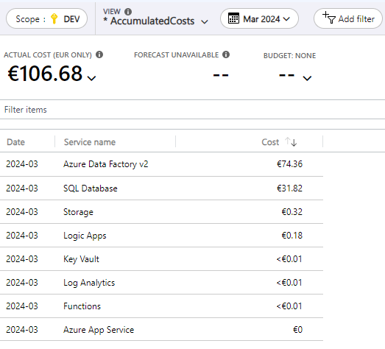
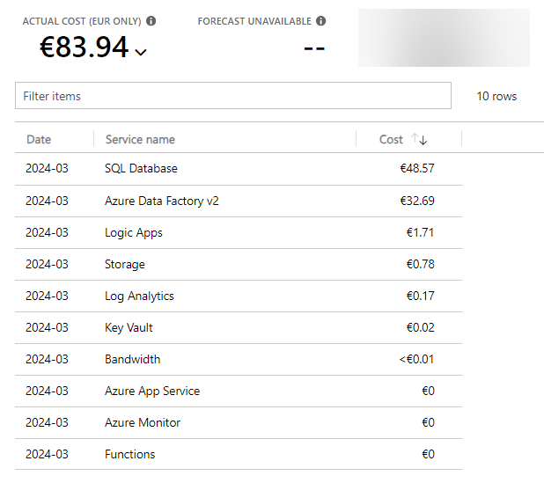
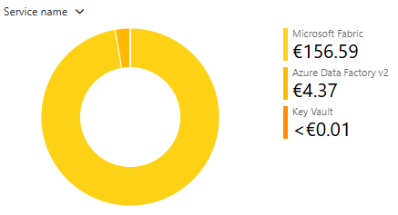
Building a €100 data warehouse

Slide 63

Thanks for listening!
(please leave feedback and check out the sponsors)

